Slide 1
Needfinding: Student Burnout
Team EduCAUtion
Notes:
Neha

Slide 2
How can academic burnout be better identified and managed by faculty and students?
Notes:
Neh

Slide 3
OUR INTERVIEWEES
2
3
3
Undergrads
Working Professionals
Grad students

Slide 4
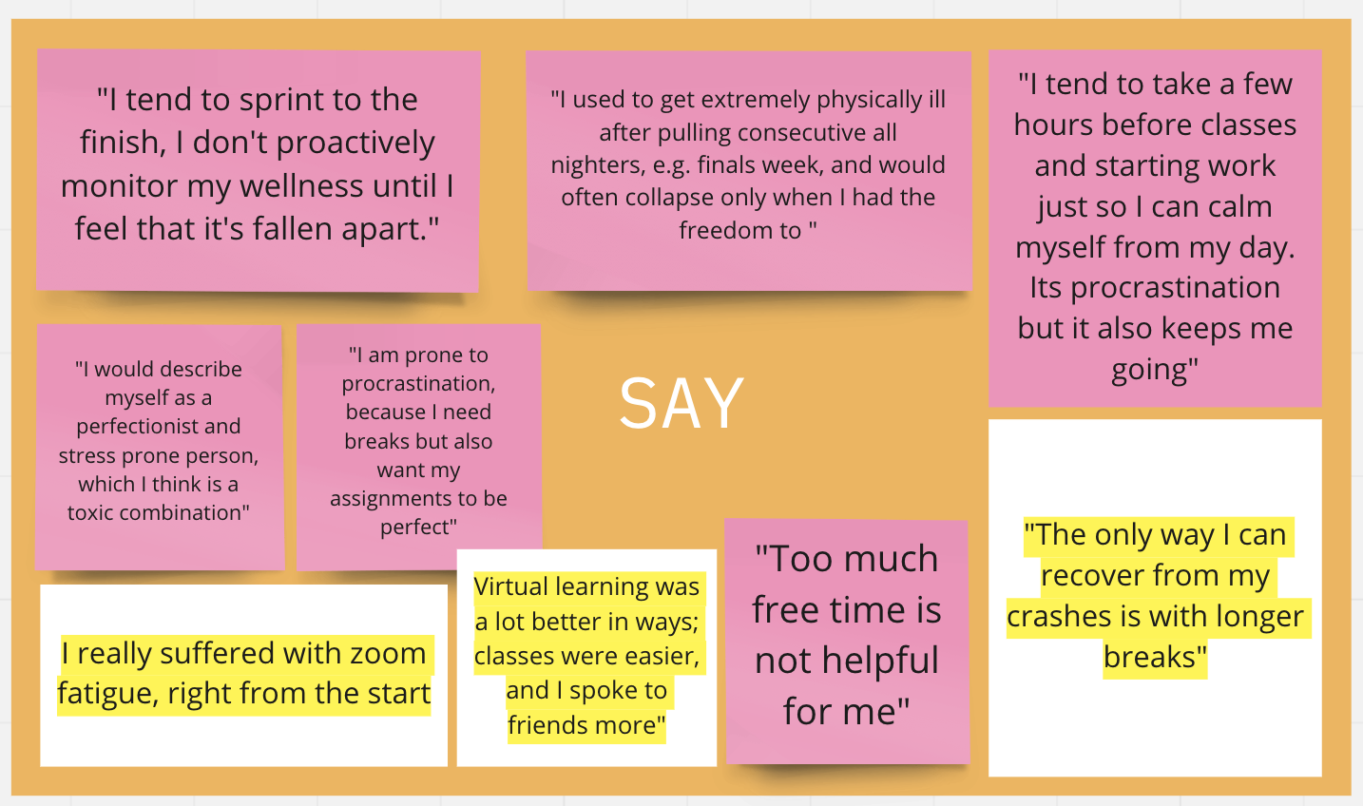
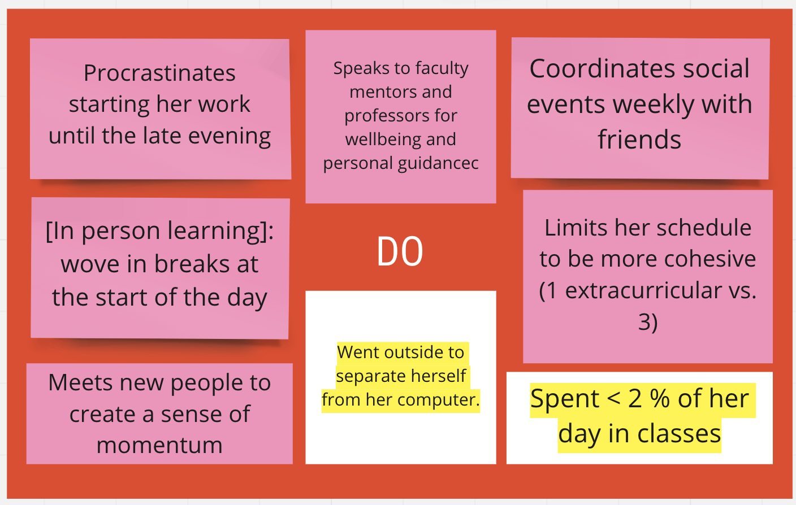
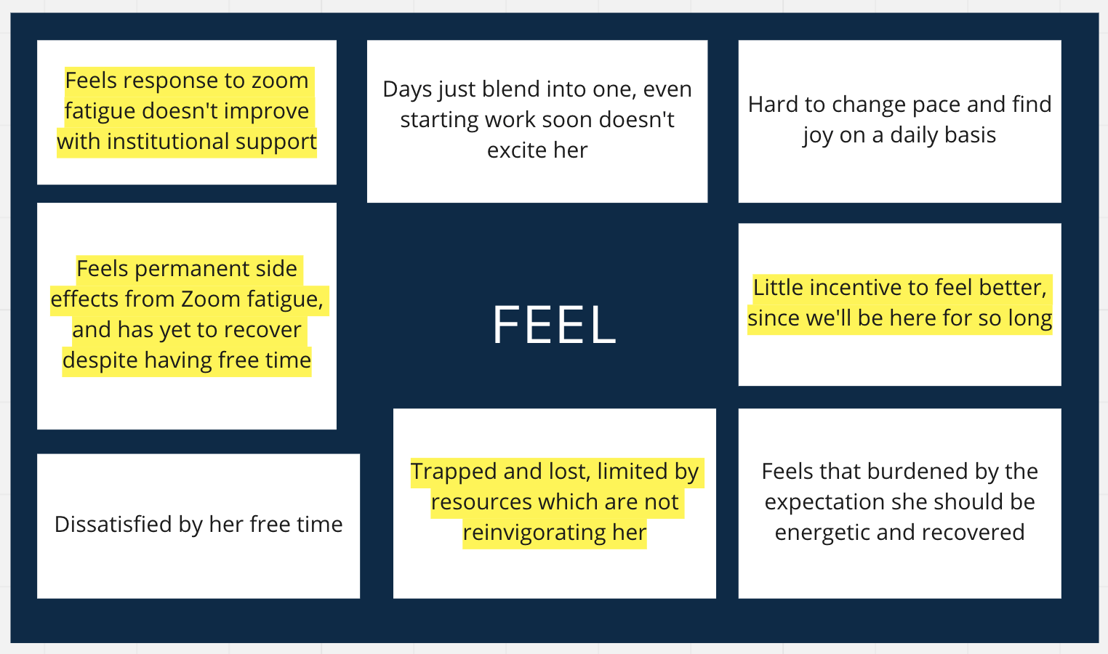
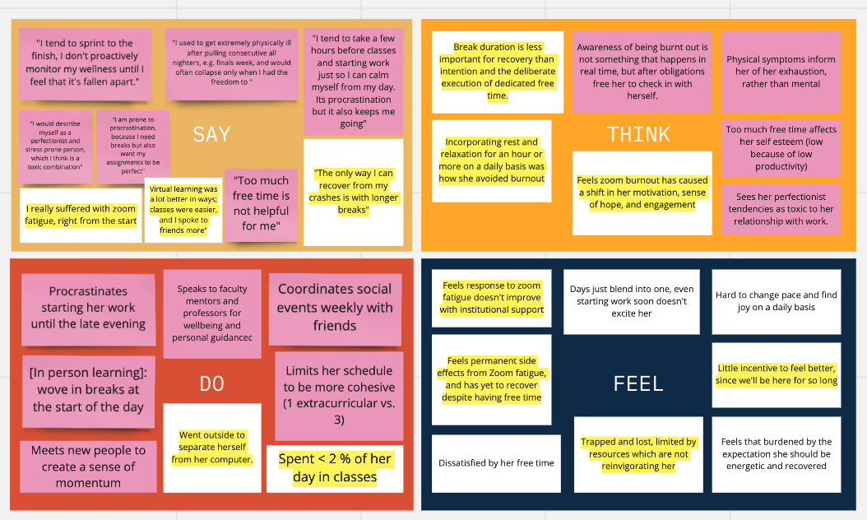
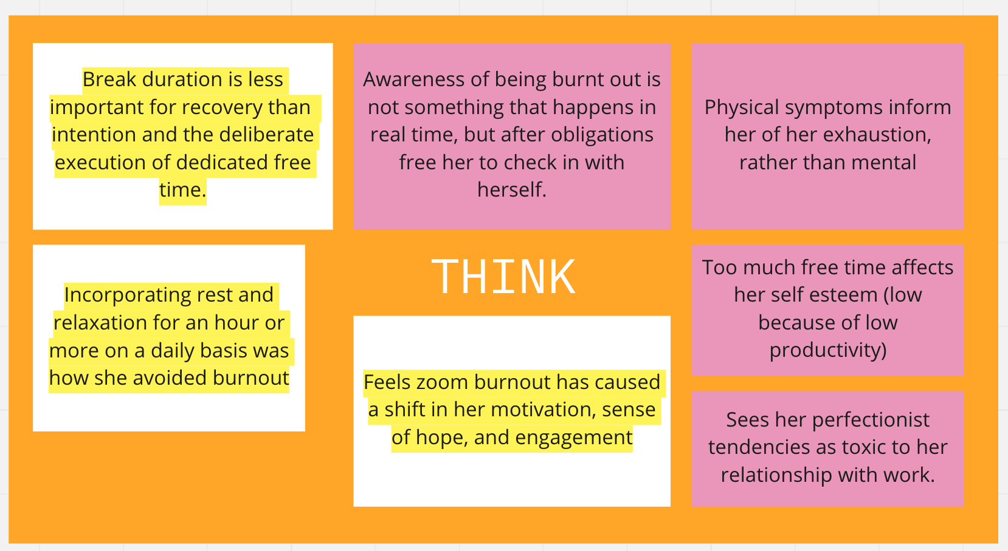
Julia — Newly graduated, working professional
Notes:
Isha

Slide 5
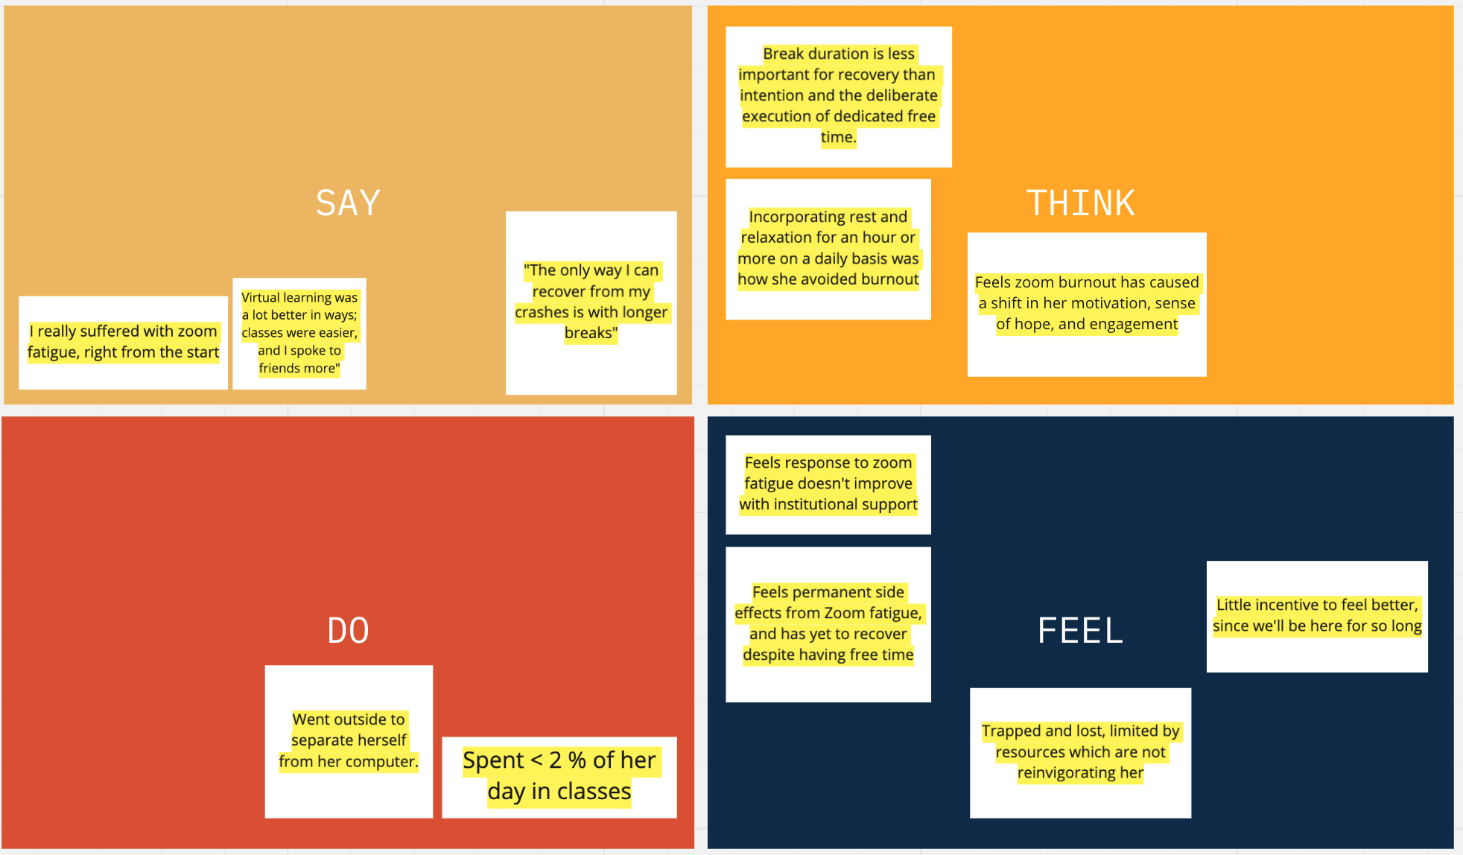
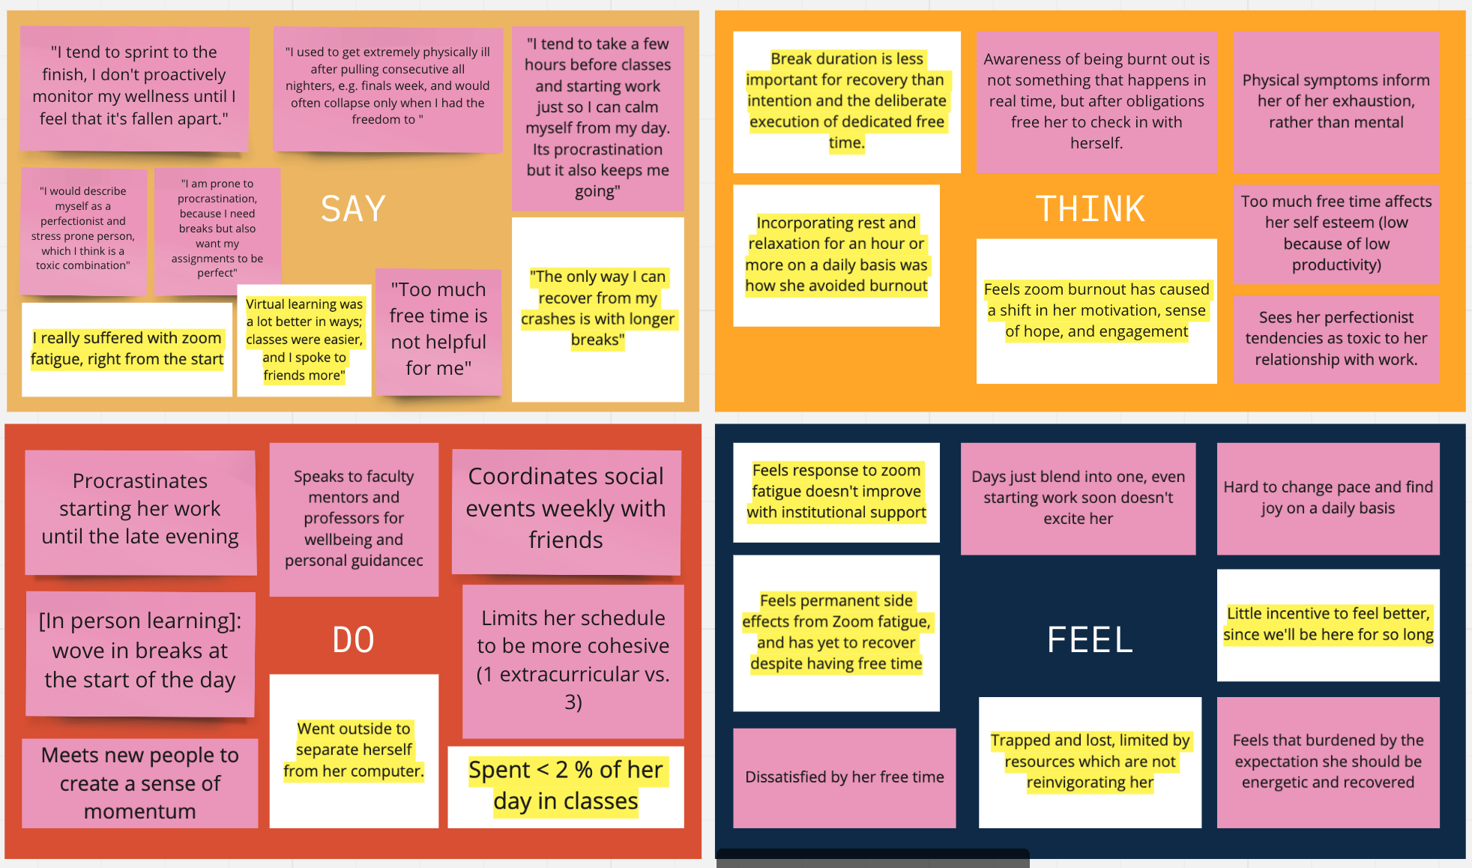
Julia — Newly graduated, working professional

Slide 6
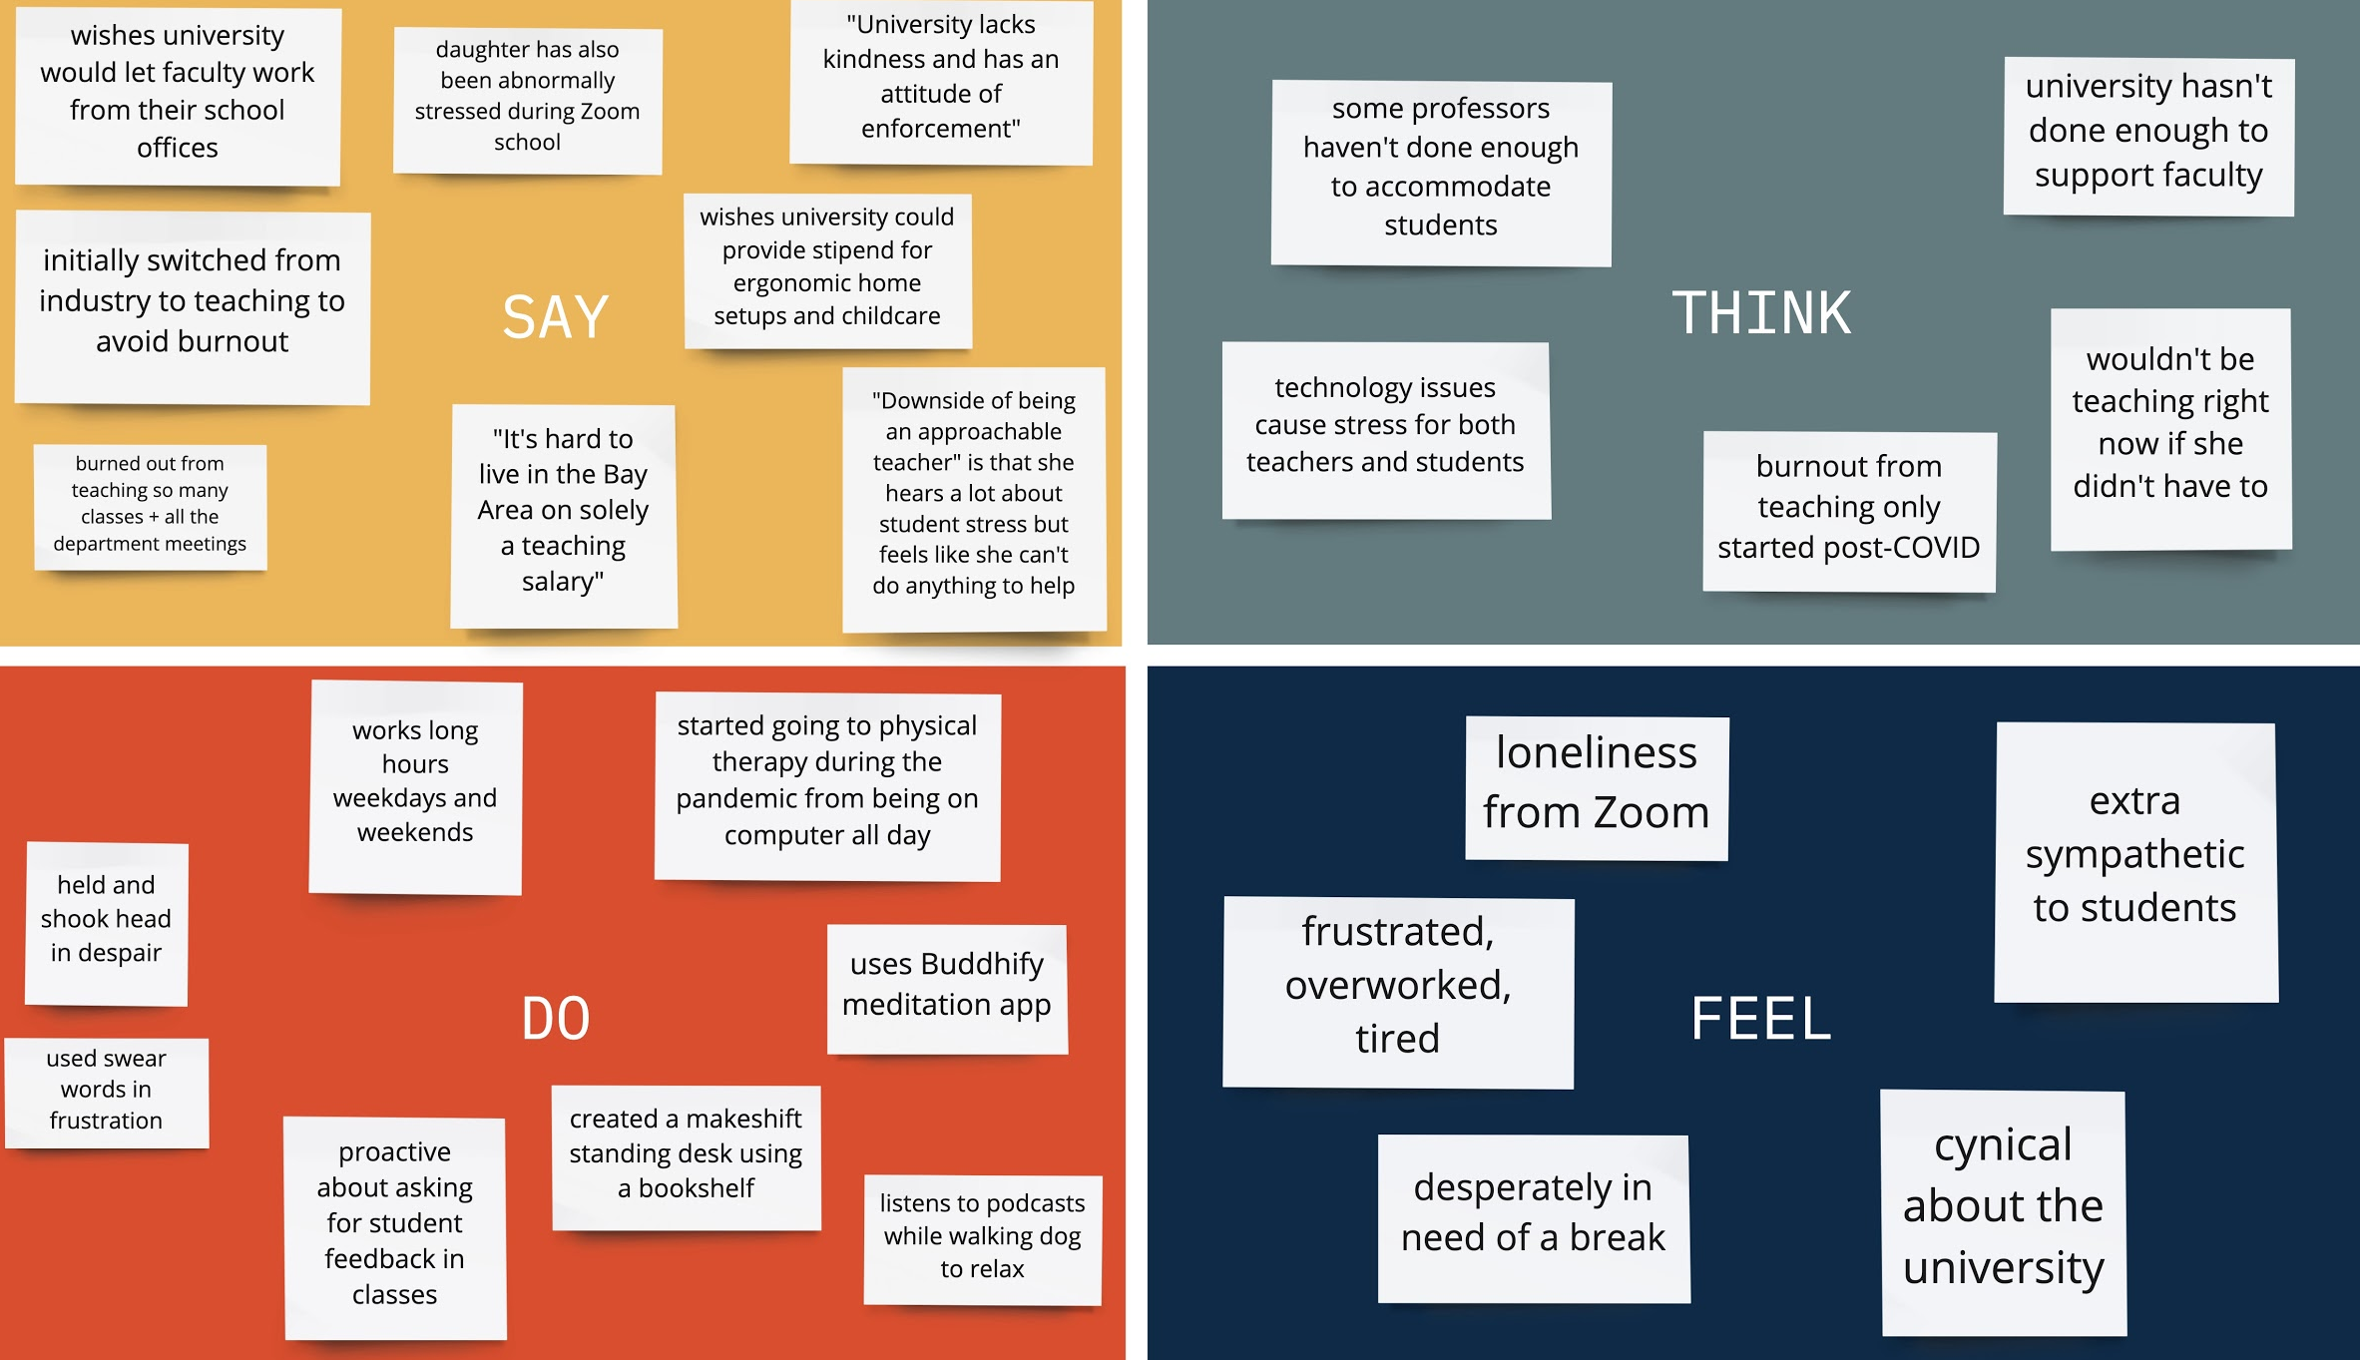
Jamie - University Lecturer
Notes:
Victoria (Christina interview)

Slide 7
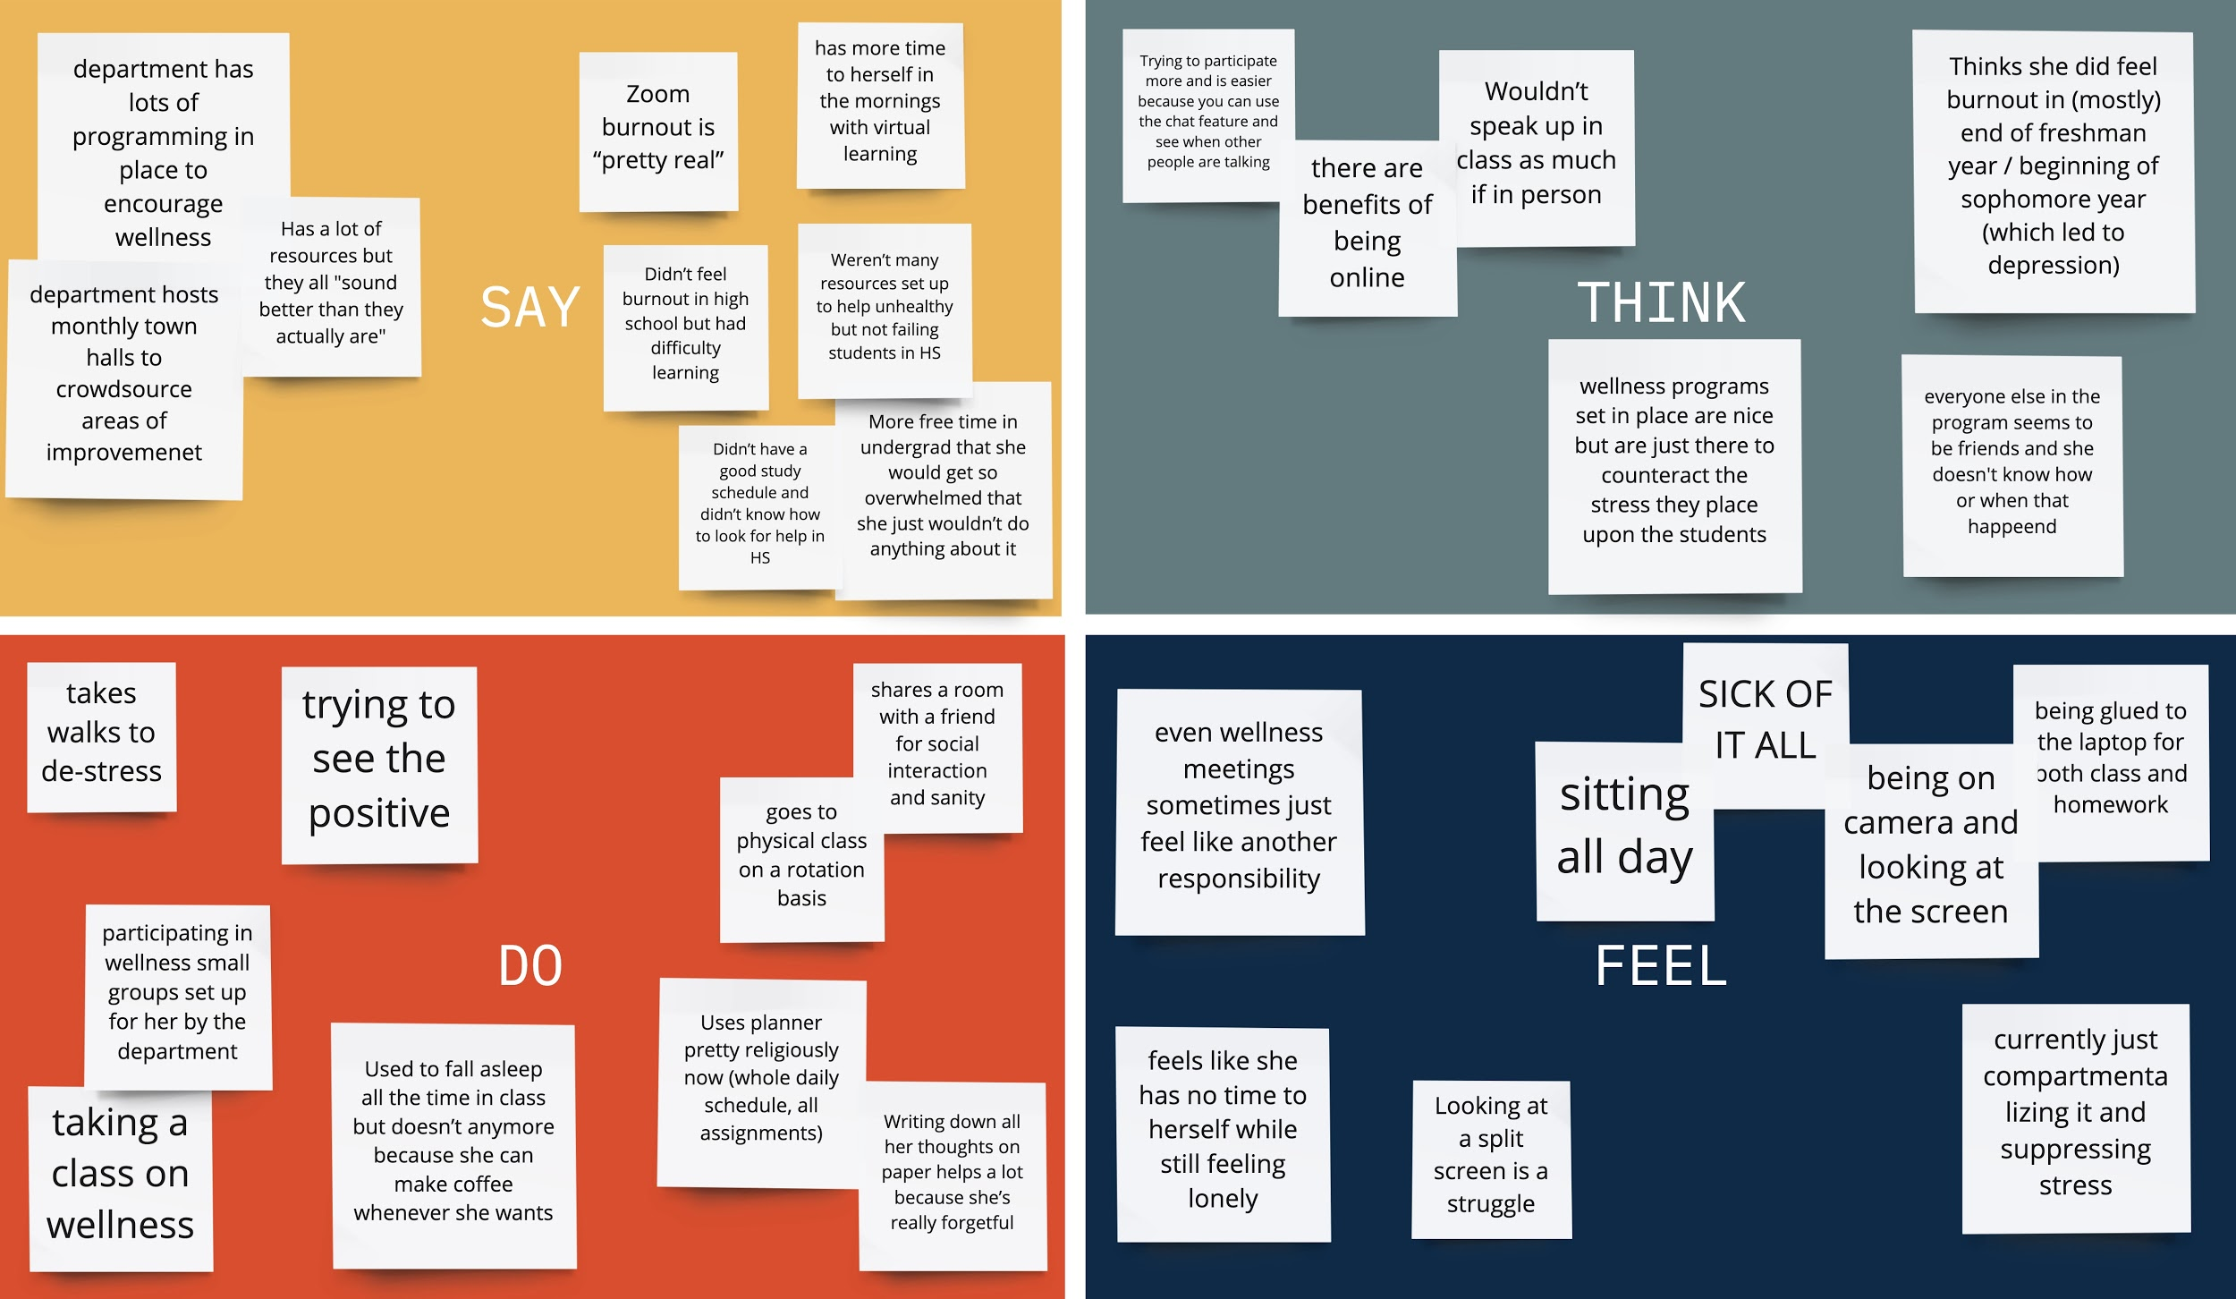
Alice - Pre-Professional Graduate Student

Slide 8
How Virtual Learning has Affected Burnout
62.5%
and yet
100%
reported that virtual learning alleviated* their traditional stressors
reported that virtual learning led to acute burnout
*to any degree
Notes:
Neha

Slide 9
SUMMARY
TENSIONS
SURPRISES
Zoom is both better and worse for student’s health-- :) better accommodations but also :( loneliness
Some people don’t associate unhealthy levels of stress with burnout
CONTRADICTIONS
INSIGHTS
Several students reported that Zoom improved their relationships. One student noted no significant changes in learning, just physical limitations.
Landscape of burnout is changing due to Zoom fatigue. The difference between traditional stress & Zoom fatigue is that people can no longer escape their problems
Notes:
Feedback Notes-- wish that empathy maps (all notes with contradiction) on one page
Wish that sticky notes went away--reduce clutter
Q: Do people concretely notice when they are becoming burn out? How long does it take to notice?
Addressing the physical part of wellbeing
Feeling lazy while spending the whole day on zoom
Wanting to help people while not having enough time to help people.

